Slide 1

Brewing Fermentation Flavors
Mike Babb
Presentation to
Science Café
9/8/08

Slide 2
Brewing Fermentation Flavors
What are some of the brewing fermentation flavor compounds?
What influences their production?
Sensory evaluation of some of these flavor compounds

Slide 3
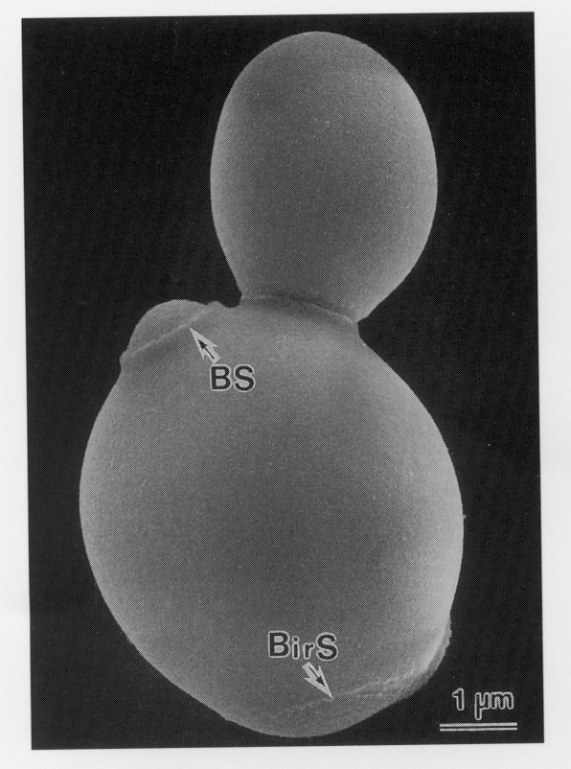
Beer Fermentation
General Concept
WORT
(sugars, amino acids, etc.)
Yeast growth
Ethanol + CO₂
Many other flavor active compounds

Slide 4
Typical flavor levels
____________________________
Fermentation Product Levels
____________________________
  Ethanol, CO₂ , Glycerol g/l
  Higher Alcohols, Organic acids,
  Short-chain fatty acids, Esters mg/l = ppm
  Aldehydes, SO₂
  H₂S, Diacetyl μg/l = ppb
_____________________________

Slide 5
Sensory Evaluation the sensory analyst as an instrument
Evaluates
  appearance, color, clarity
  aroma, odor, fragrance
  taste, flavor
  tactile sensations – burning, cooling, tingling
> 1,000 aromas and flavors in beer
most develop during beer fermentation

Slide 6
Basic Sensory Procedure for beer
Aroma impressions first
  cover glass with (clean) hand and swirl
  2-3 short sniffs
  1 long sniff
Small sip
Allow sample to sit on tongue for a moment, then swallow
Exhale through nose

Slide 7
Beer Fermentation Flavors
WORT
(sugars, amino acids, etc.)
bacteria, wild yeast
Phenols
Glycerol
Yeast autolytic
compounds
HigherAlcohols
(fusel oils)
Aldehydes
& Ketones
Esters
Sulfur compounds
Acids (organic & fatty)

Slide 8
Glycerol Production by Yeast
Glycerol is quantitatively one of the most important products of yeast fermentation and contributes to the viscosity and “body” of beer (and wine).

Slide 9
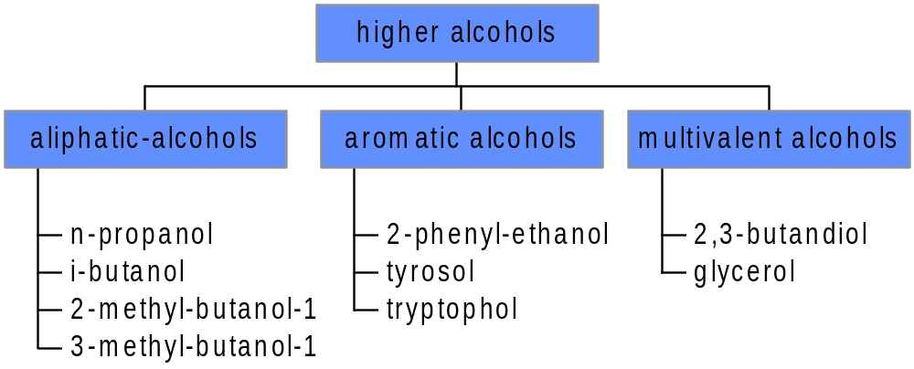
Higher Alcohols

Slide 10
Higher alcohols
increased by
  high fermentation temp
  mixing during fermentation
  low concentration of amino-acids in wort
  intensive aeration
  high gravity
reduced by
  high pitching rate
  cold pitching temperature and fermentation
  pressure during fermentation
  avoid oxygen after pitching
  enough amino-acids
80 % of higher alcohols are built during fermentation
they can´t be influenced during maturation

Slide 11
Ester production by yeast
Over 90 distinct esters in beer - flowery and fruity flavors and aromas
Desirable at low concentrations, but undesirable at high concentrations
Important esters: isoamyl acetate, ethyl acetate, isobutyl acetate, ethyl caproate, 2-phenyl acetate

Slide 12
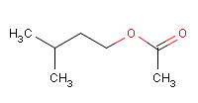

Isoamyl Acetate ester
  Active Component:
    isoamyl acetate, 3-methylbutyl acetate
  Associated Terms:
    banana, pear drops
  Typical Concentration in Beer:
    0.8 – 6.6 mg/l (ppm)
    approximate threshold: 1.4 mg/l (ppm)
  Remarks:
    produced by yeast during fermentation
    present in all beers, plays important role in overall flavor
    major flavor character in Weiss beer

Slide 13
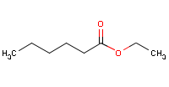

Ethyl Hexanoate ester
  Active Component:
    ethyl hexanoate, ethyl caproate
  Associated Terms:
    apple, anise
  Typical Concentration in Beer:
    0.07 – 0.5 mg/l (ppm)
    approximate threshold: 0.2 mg/l (ppm)
  Remarks:
    produced by yeast during fermentation
    present in all beers, plays important role in overall flavor, concentrations vary considerably

Slide 14
Esters
enhanced by:
  high gravity
  high fermentation degree
  low wort aeration
  low fermentation temperatures
  stirring and pumping
reduced by:
  low wort concentration
  pressure during fermentation
important components for flavor and taste
development during fermentation comparable to higher alcohols
long maturation periods can double ester concentration
ester formation competes against formation of fatty-acids

Slide 15
Organic and Fatty Acids
Production by Yeast
Around 100 acids, both organic and short-to-medium chain length fatty acids, occur in beer (some from malt, some from yeast)
Organic acids are built out of amino acids by yeast metabolism
Medium length FA's (C₁₄ - C₁₈ ) originate from wort
Shorter length FA's (C₆-C₁₂) originate from yeast metabolism

Slide 16
Carbonyls
Production by Yeast
Several carbonyls have important flavor effects on beer:
  acetaldehyde
  diacetyl

Slide 17
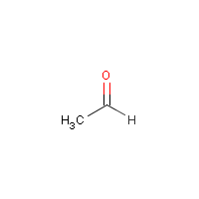

Acetaldehyde aldehyde
  Active Component:
    acetaldehyde
  Associated Terms:
    aldehydic, unripe apples
  Typical Concentration in Beer:
    2 – 15 mg/l (ppm)
    approximate threshold: 5 – 15 mg/l (ppm)
  Remarks:
    produced by yeast during fermentation
    present in all beers, off-flavor at high concentrations
    can also be formed by contaminating bacteria

Slide 18
Acetaldehyde –
Green Beer Flavor
Concentration increases by:
  intensive fermentation
    high fermentation temperature
    excessive wort aeration
    stirred fermentations
  high pitching rates
  high wort pH
  pressure during fermentation
  bacterial infection
Concentration reduces by:
  intensive post-fermentation
  and maturation
  high yeast concentration
  during maturation
  can be complexed by sulfite

Slide 19
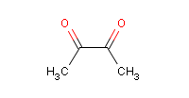

Diacetyl diketone
  Active Component:
    2,3-butanedione
  Associated Terms:
    buttery, butterscotch
  Typical Concentration in Beer:
    8 – 600 µg/l (ppb)
    approximate threshold: 10 – 40 µg/l (ppb)
  Remarks:
    produced by yeast during fermentation, closely managed by brewers
    can also be formed by contaminating bacteria

Slide 20
Factors affecting Diacetyl Formation
Increased by:
  As adjunct level is 20 - 40%, diacetyl levels double
  When adjunct is 50%, diacetyl levels double again
  Fast yeast growth rate (increased acetolactate excretion)
  High amino nitrogen in wort (increases acetolactate pre-cursor)
  Premature yeast flocculation (increases diacetyl)
Reduced by:
        low wort pH
        active yeast
        high yeast cell count
        low fermentation pressure
        low fermentation temperature and
        higher end fermentation temperatures
        long storage on yeast (diacetyl rest)

Slide 21
Sulfur Components
Sulfur components
  SO₂ produced by yeast
  H₂S from sulfur containing amino-acids and produced by yeast
  mercaptans have low flavor threshold

Slide 22
Sulfur Aromas
increased by:
  low wort oxygenation
  restricted yeast growth
  slow fermentation
  poor venting of fermenter gas
  time on yeast
  short storage time

Slide 23
Yeast Autolysis
Flavors and Aromas
Gives meat-like flavors and aromas, harsh bitterness
  Yeast viability significantly decreases
  Yeast releases proteases
  pH increases
Increased by:
  Length of time beer sits on yeast
  Temperature of yeast
Reduced by:
  Timely remove settled yeast

Slide 24
Production of
Phenolic Compounds
The presence of phenolics in beer is generally undesirable (except Wiessbier) as they impart medicinal or herbal off-flavors.
Some wild yeasts possess the POF (phenolic off-flavor) gene, and can decarboxylate ferulic acid (from malt) to 4-vinyl guaiacol

Slide 25
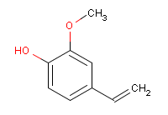

Phenolic phenol
  Active Component:
    4-vinyl guaiacol, 2-methoxy-4-vinyl-phenol
  Associated Terms:
    spicy, clove
  Typical Concentration in Beer:
    0.05 – 0.55 mg/l (ppm)
    approximate threshold: 0.2 mg/l (ppm)
  Remarks:
    produced by specialty yeasts for Weiss beer character
    can be formed by contaminating wild yeast

Slide 26
Summary
Increasing Yeast Pitching Rate
    Ethyl Acetate (solvent)
    Iso-amyl Acetate (banana)
    Higher Alcohols

Slide 27
Summary
Increasing Wort Oxygenation
    Higher Alcohols
    Esters
    SO₂
    Acetaldehyde
    Diacetyl

Slide 28
Summary
Increasing Fermentation Temperature
    SO₂
    Acetaldehyde
    Higher Alcohols
    Esters
    Diacetyl (depending upon flocculation)

Slide 29
Summary
Increasing Fermentation Counter-Pressure
  – less yeast growth
    Dissolved CO₂
    Acetaldehyde
    Diacetyl
    Esters
    Higher Alcohols

Slide 30
Summary
Control of Fermentation Flavors
Important Factors
YEAST
  Strain
  Pitching rate and consistency
  Viability (autolytic “yeasty” flavours)
  Contaminants
WORT
  Gravity, pH, dissolved oxygen, contaminants, yeast foods
FERMENTATION
  Design/geometry, temperature, pressure

Slide 31
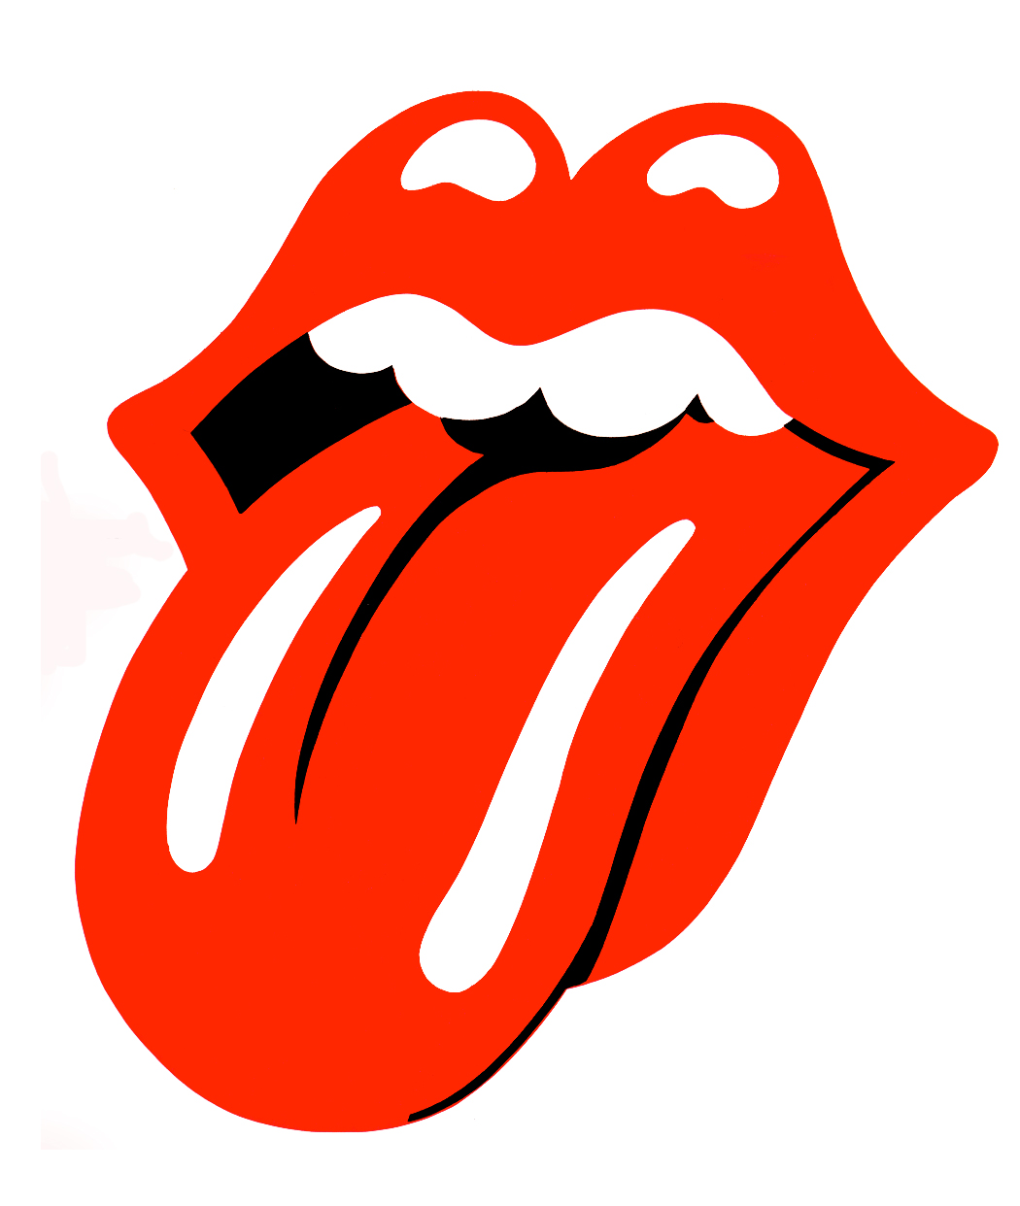
Sensory Evaluation the sensory analyst as an instrument

